Slide 1
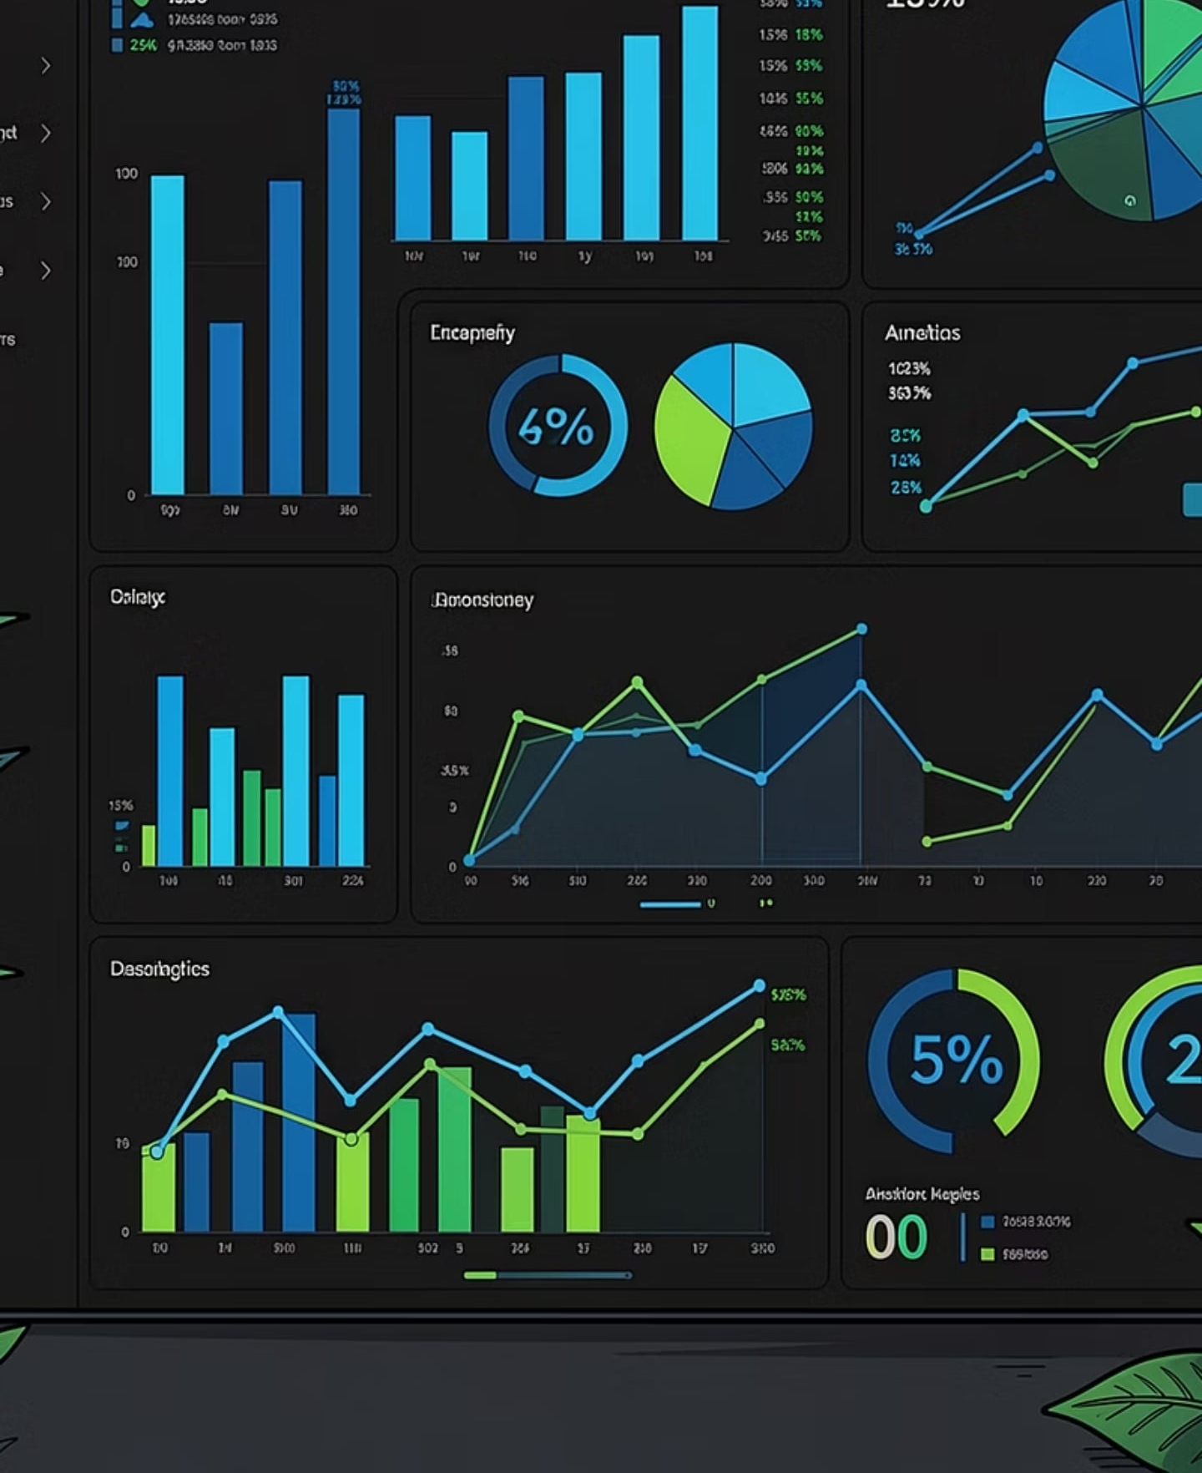
DATA ANALYTICS
RETAIL INSIGHTS
Customer Shopping Behavior Analysis
Analyzing 3,900 purchases across product categories to uncover spending patterns, customer segments, product preferences, and subscription behavior for strategic business decisions.

Slide 2
Dataset Summary
3,900
18
37
Total Purchases
Columns
Missing Values
Review Rating column
Key Features
Customer demographics: Age, Gender, Location, Subscription Status
Purchase details: Item, Category, Amount, Season, Size, Color
Shopping behavior: Discount, Promo Code, Previous Purchases, Frequency, Review Rating, Shipping Type

Slide 3
Exploratory Data Analysis in Python
Data Preparation Pipeline
01
02
Data Loading
Missing Data Handling
Imported dataset using pandas
Imputed Review Rating using category median
03
04
Feature Engineering
Database Integration
Created age_group and purchase_frequency_days columns
Loaded cleaned data into MySQL

Slide 4
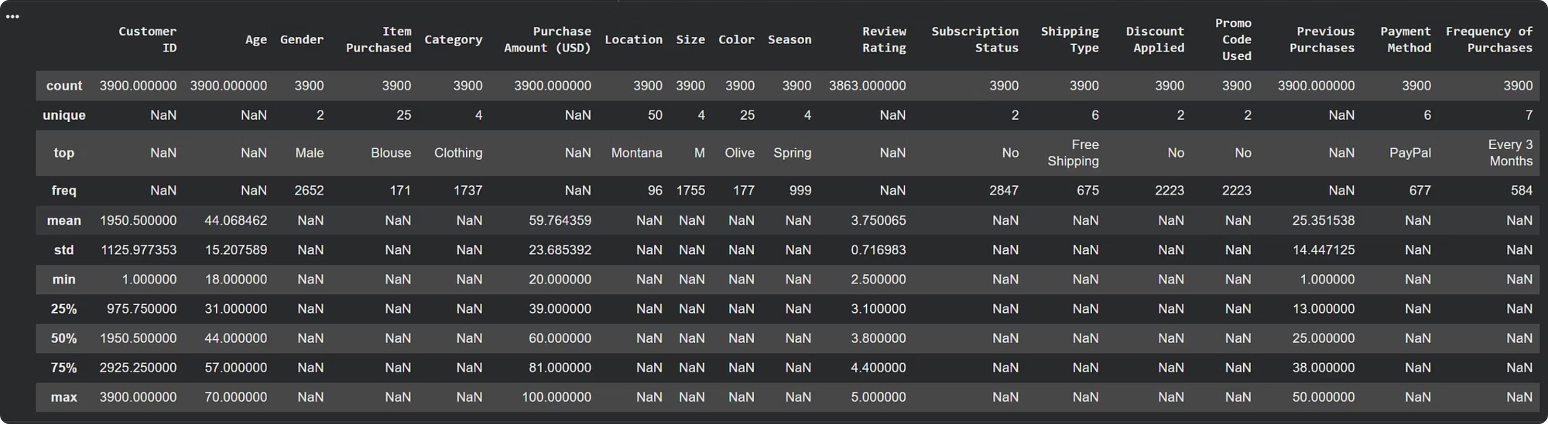
Dataset at a Glance
Summary statistics from initial exploration using df.describe()

Slide 5
Key Numerical Statistics
A detailed overview of the central tendency, dispersion, and shape of the distribution of numerical features within the dataset.
Metric
Count
Mean
Std
Min
25%
50%
75%
Max
Age
3900
35.2
10.5
18
28
34
42
65
Amount (USD)
3900
60.8
25.3
10
40
58
75
150
Previous Purchases
3900
15.1
8.2
0
8
15
22
35
Review Rating
3900
4.1
0.7
1.5
3.8
4.2
4.5
5.0
The descriptive statistics highlight a diverse customer base in terms of age and purchase behavior. Average transaction amounts are around $60, and customer ratings generally skew positive. The "Count" for review rating is 3900, indicating successful imputation of missing values, aligning with the data preparation steps.

Slide 6
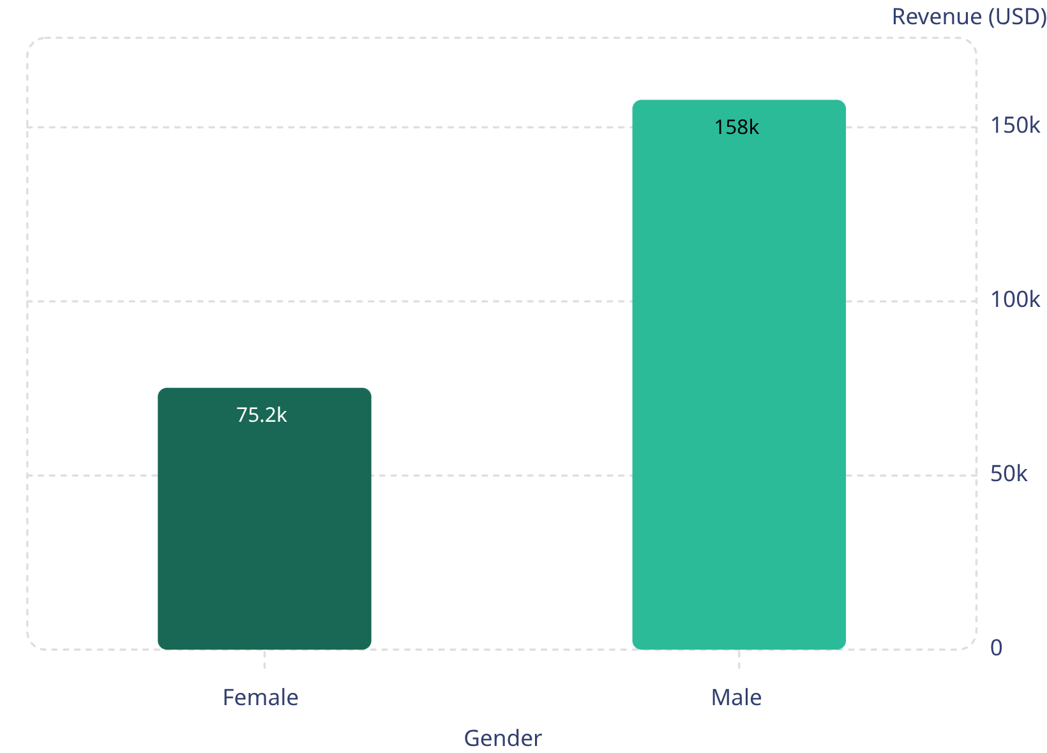
Revenue & Customer Insights
Key Findings
839 high-spending discount users spent above the $59.76 average
Standard shipping avg: $58.46 vs Express: $60.48
Subscribers: 1,053 customers, $62,645 total revenue
Non-subscribers: 2,847 customers, $170,436 total revenue
Male customers generated over 2x the revenue of female customers.

Slide 7
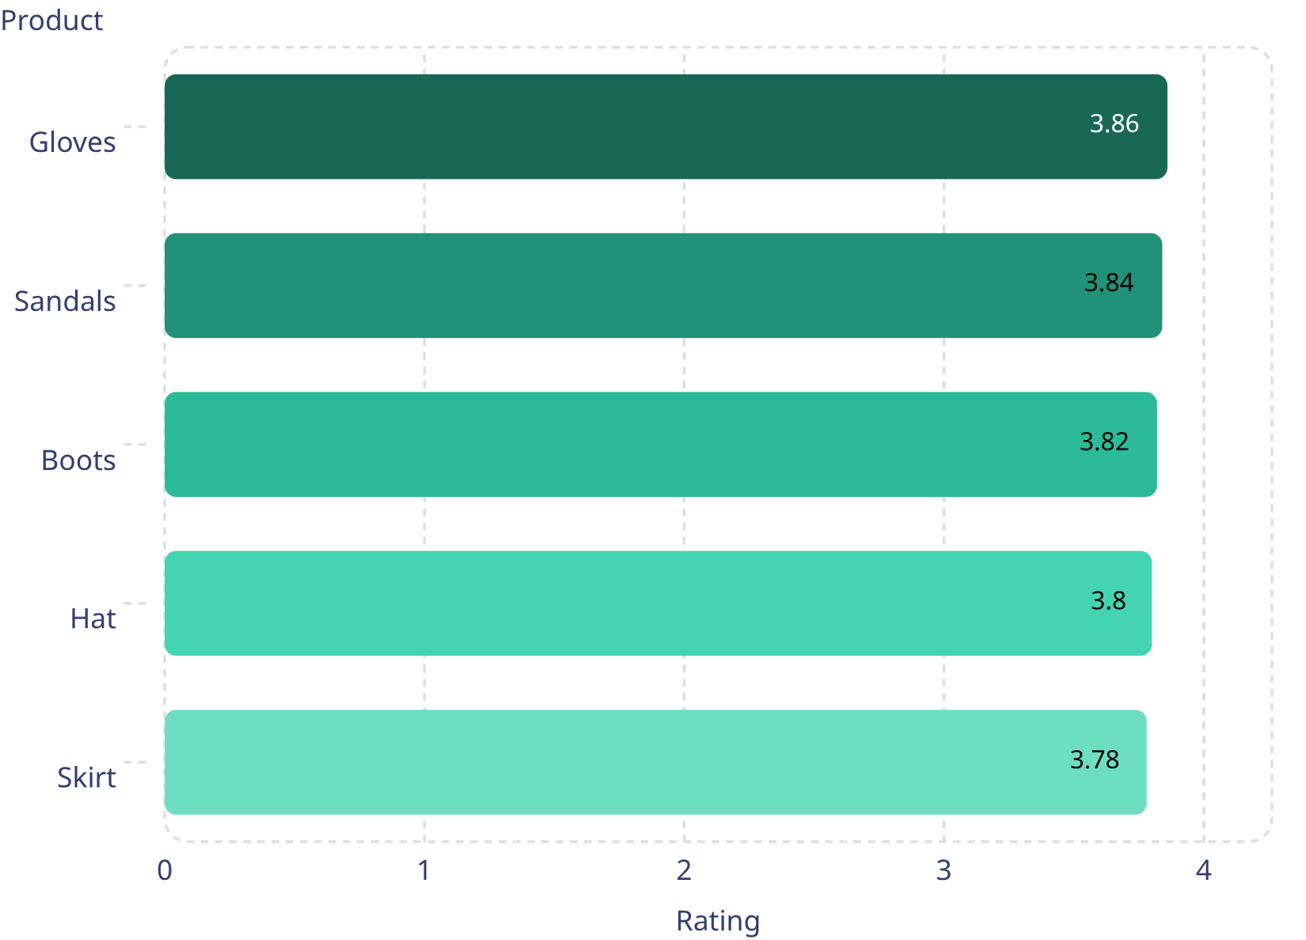
Top Products & Discount Trends
Top 5 by Rating
Highest Discount Rates
Hat — 50.00%
Sneakers — 49.66%
Coat — 49.07%
Sweater — 48.17%
Pants — 47.37%
Discount rates are clustered in a narrow range, with Hat at the highest level of 50.00% and Pants at the lowest at 47.37%. These elevated discounts suggest an aggressive pricing strategy designed to drive demand and improve competitiveness across the product mix. They may also reflect product positioning differences, where certain items require stronger promotions to move inventory or attract buyers. However, discounts this high can put pressure on profit margins, so it will be important to balance volume growth against long-term profitability.
Gloves has the highest rating at 3.86
Skirt has the lowest rating at 3.78

Slide 8
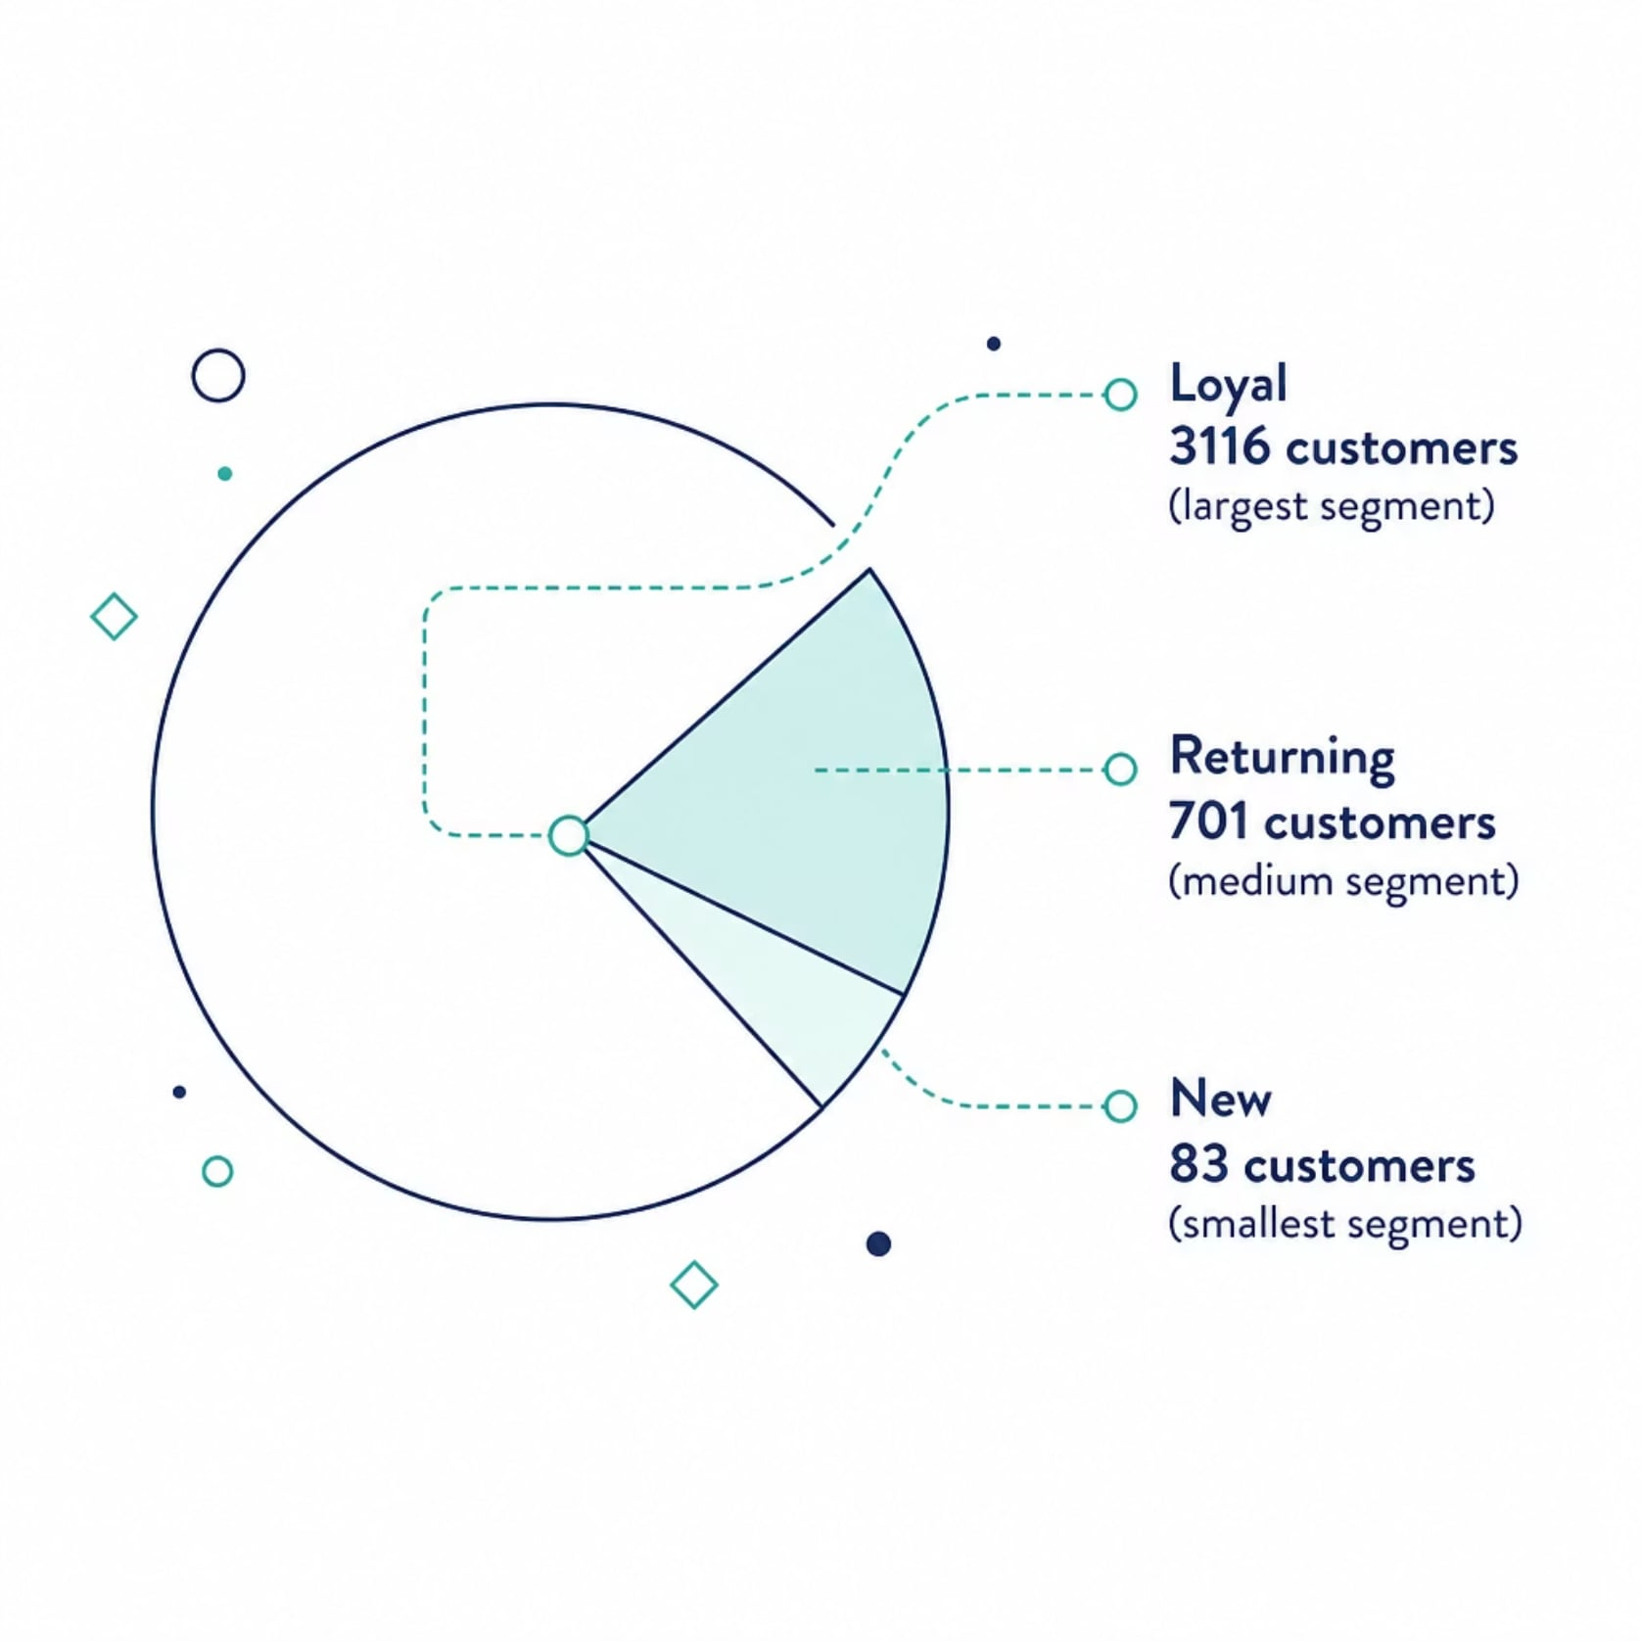
Customer Segmentation
Segment Insights
Loyal customers dominate at 3,116, forming the backbone of revenue.
Returning customers (701) represent a key growth opportunity.
New customers (83) need onboarding and retention focus.
Repeat buyers with >5 purchases: 2,518 non-subscribers vs 958 subscribers.

Slide 9
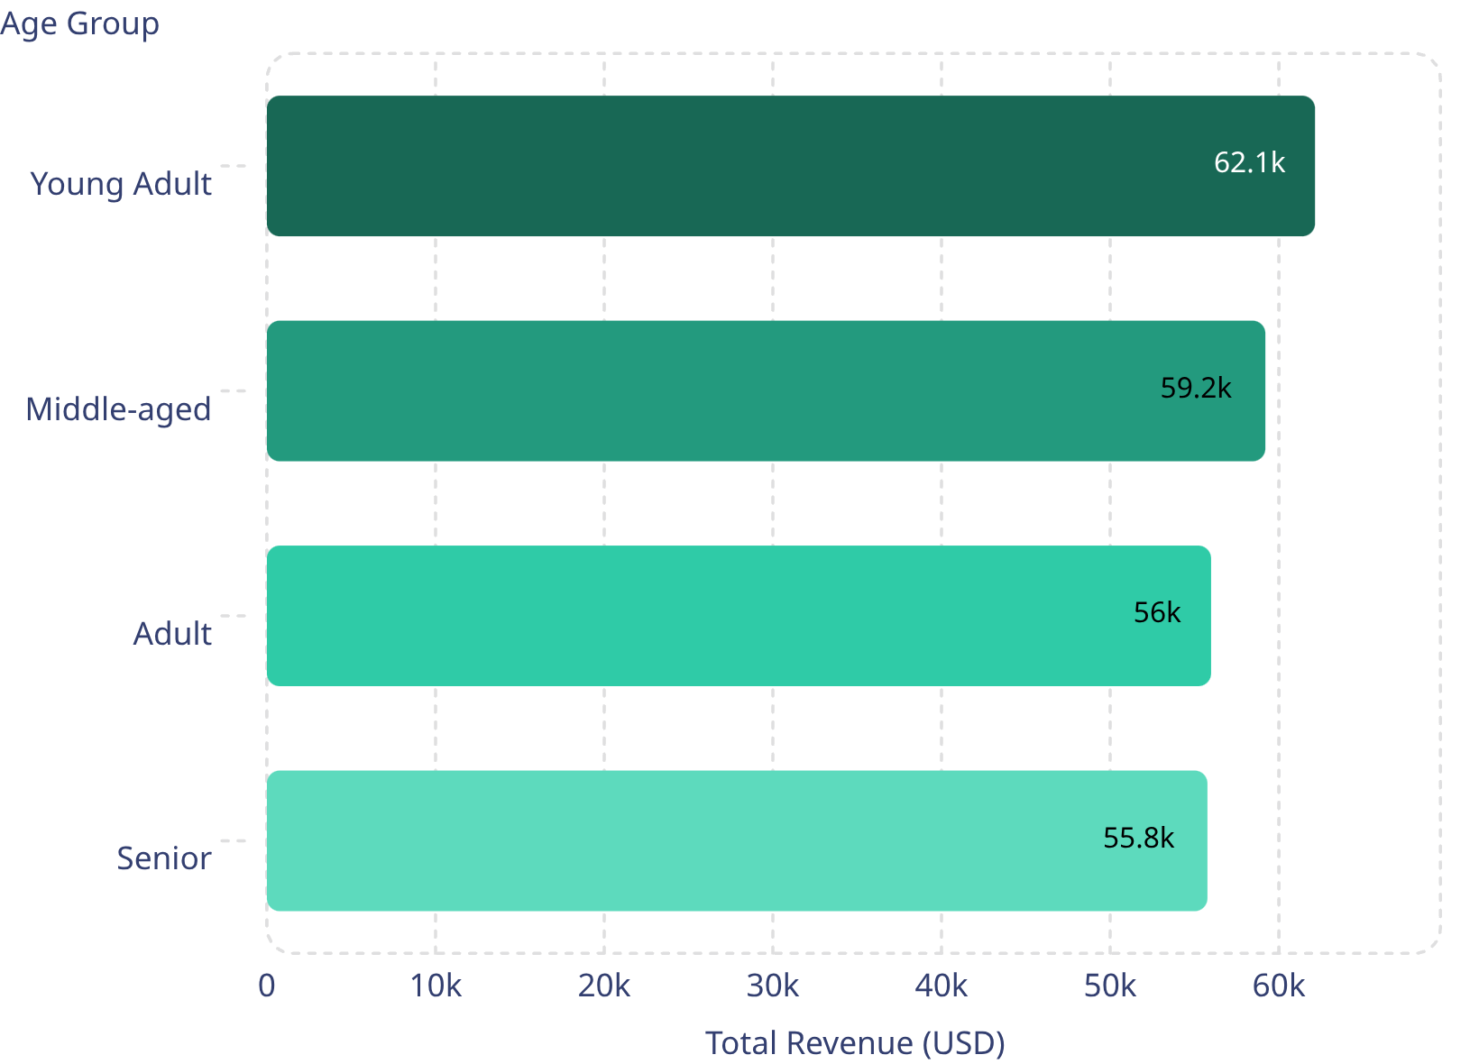
Revenue by Age Group
Top Products per Category
Accessories: Jewelry (171), Sunglasses (161), Belt (161)
Clothing: Blouse (171), Pants (171), Shirt (169)
Footwear: Sandals (160), Shoes (150), Sneakers (145)
Outerwear: Jacket (163), Coat (161)

Slide 10

Business Recommendations
These recommendations prioritize the highest-impact opportunities across subscriptions, loyalty, pricing, merchandising, and targeting.
Boost subscriptions: Promote subscriber benefits at checkout, in emails, and in remarketing.
Loyalty programs: Add points, tiered perks, and personalized offers for repeat buyers.
Review discounts: Focus promotions on slow-moving items and protect margins on strong sellers.
Product positioning: Highlight top-rated products with reviews, benefits, and comparison points.
Targeted marketing: Tailor campaigns to high-revenue age groups and ex
press-shipping users.

